Slide 1






Affective Computing backgrounder
ADOPT
READINESS
ADOPT
STUDY
Emerging Technology Innovation Board (ETIB)
2020-09-01
Shamir Alavi
SC&D, ITAS

Slide 2
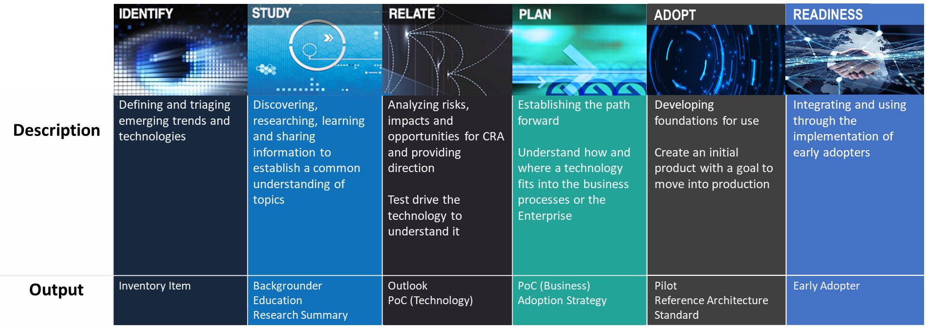
In the Research Model
Affective Computing
Notes:
The research model shows all research relating to emerging trends and disruptive technologies. Decisions are made at on whether to “park it” or “pursue it” as topics move through the phases.

Slide 3
What is Affective Computing?
Notes:
Optional intro: https://www.youtube.com/watch?v=bWyhsqh_e9s
C:\Users\sxa401\AI\affective-computing\

Slide 4
What is Affective Computing
Affect
Experiences related to or resulting from feeling, emotion or mood
Affective Computing
Development of systems that can interpret and simulate human affects
Proposed in 1995

Slide 5
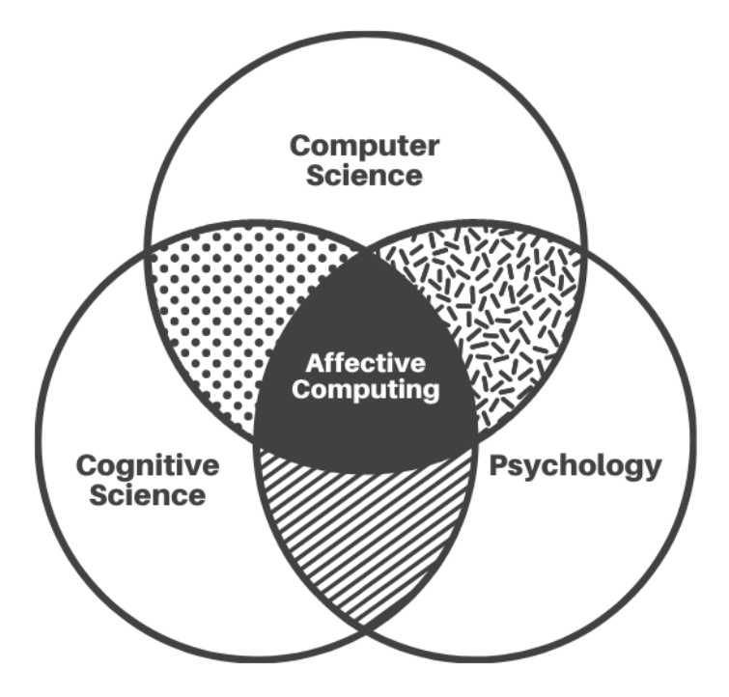
What is Affective Computing

Slide 6
Affective Computing: Motivations
To simulate emotional intelligence (e.g. empathy)
Develop machines/devices that can interact according to the user’s emotion/mood
Notes:
Machines/devices/computers

Slide 7
Affective Computing: Motivations
During an interaction, an intelligent machine should be able to:
Interpret our emotional state
Adapt its behaviour
Respond accordingly
Goal: To increase the effectiveness and credibility of its responses

Slide 8
Affective Computing
Affective Computing is not about the machine:
Losing its desired rationality while simulating emotions
Performing psychological therapy

Slide 9
Affective Computing
Affective Computing is about building smarter applications.
Conversational interfaces (e.g. chatbots)
Computer-assisted learning
Biometrics
Customer service
Healthcare etc.

Slide 10
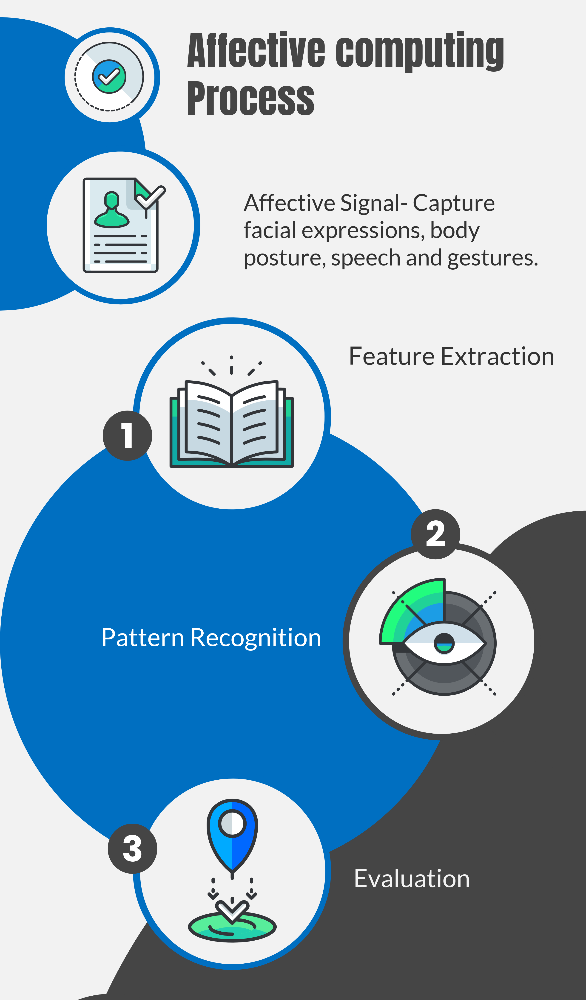
Affective Computing: Process
https://www.predictiveanalyticstoday.com/what-is-affective-computing/
Notes:
This technology is developed and implemented using the following three steps.
Capturing specific signals such as cues from facial expressions, body posture, speech and gesture.
Processing the signals, mainly using machine learning, to recognize patterns that can help the computer identify emotions specific to the task at hand.
Evaluating the identified emotions to decide how to interact with the user and take action.

Slide 11
Affective Computing: Importance
To bridge the gap between human emotion and technology
To help people communicate emotional information
To better understand the ways emotions impact our learning, behaviour and health

Slide 12
Affective Computing: Applications
Emotion recognition to track customer satisfaction
Monitoring students’ interest and attention during a lecture
To help people with special needs who face communication challenges
Finding new ways to forecast and prevent depression
Threat detection in public gatherings
Notes:
Using voice-based emotion recognition, companies are tracking customer satisfaction. They are using this to make real-time adjustments to their processes or offer real-time guidance to their personnel. This can be applied to chatbots so that they can craft more intelligent responses guided by users’ emotions.
Monitoring students in classroom or online to assess their interest and attention
Using facial, gesture and body language recognition to identify potential criminals, such as terrorists in public gatherings
Trying to better manage and understand the ways emotion impacts health, social interaction, learning, memory, and behaviour.
Finding new ways to forecast and prevent depression.
Inventing ways to help people with special needs who face communication, motivation and emotion regulation challenges.
Monitoring emotional state of drivers as they are driving, to ensure road safety.

Slide 13
Affective Computing: Ethics
Emotions are subjective
Gestures, facial expressions and tones vary from culture to culture
Lack of cultural diversification in training datasets can introduce bias in results

Slide 14
Affective Computing: Future
Smarter chatbots
Growing demand for voice-enabled virtual assistants
Computer-assisted education
Enhanced security in banking and automotive sectors
Diagnosis and treatment of mental health issues
Notes:
chatbots will become smarter as we provide them the ability to detect a wide variety of human emotions while they interact with users

Slide 15
Approval Requested
ETAIC recommendations
Park
Keep an eye on the evolution of Chatbot technology

